Slide 1
Leadership
Lesson 8
Erbolat Tulepbayev

Slide 2
Theory development
Why do some people become leaders and others don't?
What qualities does a person need to possess to become a leader?
How is the process of formation of the phenomenon of leadership interrelated with the conditions in which it is carried out?
What and how should a person do to become a leader and maintain this status?

Slide 3
Approaches by which the theories of the twentieth century developed
The personalistic approach is aimed at studying the personality of the leader and his/her psychological qualities that determine the acquisition of leadership status;
The skills approach is aimed to study leadership skills as the ability to use one’s knowledge and competencies to accomplish a set of goals or objectives;
The situational approach is aimed at studying the situational context of the leadership process;
LMX - dyadic relationship between leaders and followers.

Slide 4
Personalistic approach (leadership traits)
Outstanding leaders are such because they are born with traits that distinguish them from other people.
The concept of leadership traits originated from the theory of the great man (F. Galton - hereditary factor of leadership).
In 1940, the American researcher K. Baird compiled a single list of leadership traits from 79 names. However, an analysis of the mention of these traits by different authors showed that none of them occupied a solid place in their lists. Thus, 65% of traits were mentioned only once, 16-20% - twice, 4-5% - three times and only 5% of traits were named four times. Among the most recurring traits were named initiative, popularity, sociability, enthusiasm, confidence.
In 1948, R. Stogdill reviewed 124 studies aimed at studying the personal qualities of leaders, and noted that their results often contradict each other. In different situations, leaders have emerged, revealing different, sometimes opposite, leadership qualities. Based on the analysis, Stogdill concluded that a person does not become a leader only because he has a certain set of personal properties.

Slide 5
Personalistic approach (leadership traits)
So what's more important?
Actions are more important than personality traits!
But still, this theory has contributed to the knowledge of the necessary qualities of a leader.
W. Bennis identified six important qualities of an organizational leader:
1) guiding vision (definition of the goal and persistance in achieving it);
2) inner passion (passion for life's vocation and the use of opportunities);
3) personal integrity (maturity and wisdom of a person, introspection, self-criticism and desire to interact with others);
4) trust (reliability);
5) curiosity (self-development);
6) audacity (readiness for new challenges).

Slide 6
Personalistic approach (leadership traits)
10 qualities that increase the effectiveness of an organizational leader (A. Lawton and E. Rose, 1987):
1) Foresight - the ability to see promising goals, to form the appearance and tasks of the organization;
2) Ability to determine priorities – to distinguish what is necessary and what is simply important;
3) Ability to motivate followers;
4) Mastery of the art of interpersonal relations;
5) Political intuition - the ability to understand the needs of higher environment and persons with power;
6) Resilience and steadfastness in the face of the opponent;
7) Charisma, or charm - something difficult to define, but captivating people;
8) The ability to take risks, as well as delegate authority to followers;
9) Flexibility – the ability to respond to new ideas and experiences;
10) Determination and firmness when circumstances require.

Slide 7
R. Stogdill's Leadership Model (1974)
Stogdill, after analyzing the results of hundreds of characterological studies accumulated over the past 70 years, proposed the following personal characteristics of a successful leader:
– self-confidence and integrity of the individual;
– activity and readiness to perform tasks;
– determination and persistance in achieving goals;
– courage and originality in solving problems;
– the desire to show initiative in social situations;
– willingness to be responsible for the consequences of their decisions and actions;
– ability to relieve interpersonal tension, tolerance and resistance to difficulties;
– the ability to influence the behavior of other people and the ability to organize their interaction in joint activities, subordinating them to the fulfillment of a given task.

Slide 8
Leadership Personality Traits Theory
Skills
Governance
Inventiveness
Personal traits
Self-assurance
Determination
Masculinity/Femininity
Maturity
Intellect
Motivation
Need for professional development
Self-realization
Power over others
High financial rewards
Job security

Slide 9
What makes a person a leader?
Development
Maturity and Charisma
Analytical skills
Conceptualization of solutions
Honesty
Self-belief
Desire to lead people
Desire to reach heights
Born to be a leader

Slide 10
Skills approach
Beginning in the early 1990s, a multitude of studies have been published that a leader’s effectiveness depends on the leader’s ability to solve complex organizational problems. This research has resulted in a comprehensive skill-based model of leadership that was advanced by Mumford and his colleagues.
Leadership skills are defined as the ability to use one’s knowledge and competencies to accomplish a set of goals or objectives.
Three-skill approach
technical
human
conceptual

Slide 11
Three-skills approach
Technical skill is knowledge about and proficiency in a specific type of work or activity. It includes competencies in a specialized area, analytical ability, and the ability to use appropriate tools and techniques (Katz, 1955).
Human skill is knowledge about and ability to work with people. They are the abilities that help a leader to work effectively with subordinates, peers, and superiors to accomplish the organization’s goals.
Conceptual skills are the ability to work with ideas and concepts. A leader with conceptual skills is comfortable talking about the ideas that shape an organization and the intricacies involved.

Slide 12
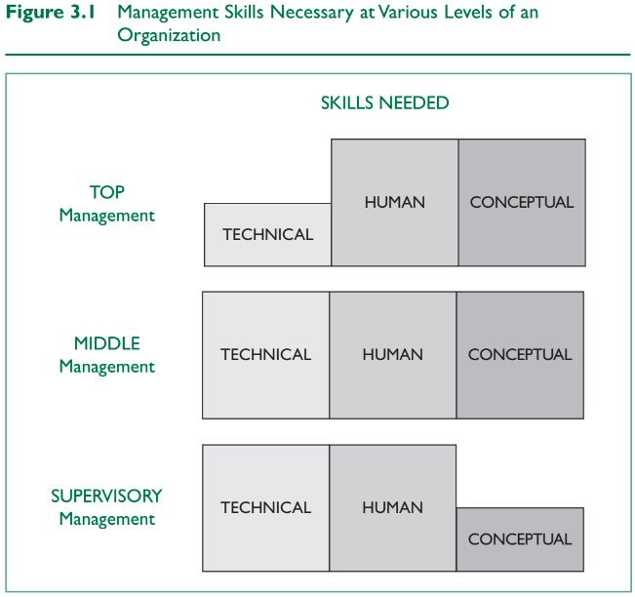
Three-skills approach

Slide 13
Skill-based model
Beginning in the early 1990s, a group of researchers, with funding from the U.S. Army and Department of Defense, set out to test and develop a comprehensive theory of leadership based on problem-solving skills in organizations. The studies were conducted over a number of years using a sample of more than 1,800 Army officers, representing six grade levels, from second lieutenant to colonel. The project used a variety of new measures and tools to assess the skills of these officers, their experiences, and the situations in which they worked.
What accounts for why some leaders are good problem solvers and others are not? What specific skills do high-performing leaders exhibit? How do leaders’ individual characteristics, career experiences, and environmental influences affect their job performance?
Based on the extensive findings from the project, Mumford and colleagues formulated a skill-based model of leadership. The model is characterized as a capability model because it examines the relationship between a leader’s knowledge and skills (i.e., capabilities) and the leader’s performance (Mumford, Zaccaro, Harding, et al., 2000, p. 12).

Slide 14
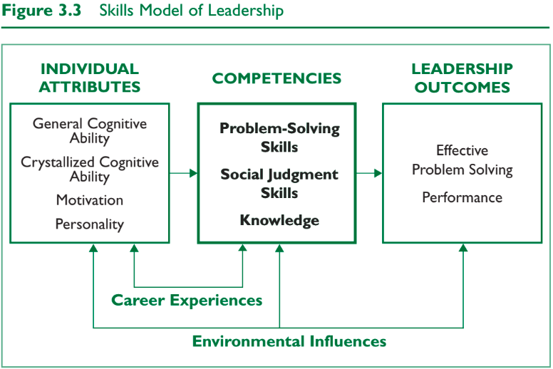
Skill-based model
The skill-based model of Mumford’s group has five components: competencies, individual attributes, leadership outcomes, career experiences, and environmental influences.

Slide 15
Skill-based model - Competencies
According to Mumford, Zaccaro, Harding, et al. (2000), problem-solving skills are a leader’s creative ability to solve new and unusual, ill-defined organizational problems. The skills include being able to define significant problems, gather problem information, formulate new understandings about the problem, and generate prototype plans for problem solutions.
In general, social judgment skills are the capacity to understand people and social systems (Zaccaro, Mumford, Connelly, Marks, & Gilbert, 2000, p. 46). They enable leaders to work with others to solve problems and to marshal support to implement change within an organization. Mumford and colleagues have delineated social judgment skills into the following: perspective taking, social perceptiveness, behavioral flexibility, and social performance.
Perspective taking means being sensitive to other people’s perspectives and goals—being able to understand their point of view on different issues.
Social perceptiveness is insight and awareness into how others in the organization function.
Behavioral flexibility is the capacity to change and adapt one’s behavior in light of an understanding of others’perspectives in the organization.
Social performance includes a wide range of leadership competencies (communication, mediating problems, coaching etc.).
Knowledge

Slide 16
Skill-based model - Individual attributes
General cognitive ability can be thought of as a person’s intelligence. It includes perceptual processing, information processing, general reasoning skills, creative and divergent thinking capacities, and memory skills.
Crystallized cognitive ability is intellectual ability that is learned or acquired over time. It is the store of knowledge we acquire through experience.
Motivation:
Leaders must be willing to tackle complex organizational problems.
Leaders must be willing to express dominance—to exert their influence.
Leaders must be committed to the social good of the organization.
Personality (openness, tolerance for ambiguity, curiosity, confidence, adaptability and etc.)

Slide 17
Skill-based model - Leadership outcomes
Good problem solving involves creating solutions that are logical, effective, and unique, and that go beyond given information.
Performance outcomes reflect how well the leader has done her or his job.
Career experiences
Environmental influences
Internal environmental influences affecting leadership performance can include such factors as technology, facilities, expertise of subordinates, and communication.
External environmental influences, including economic, political, and social issues, as well as natural disasters, can provide unique challenges to leaders.

Slide 18
Skills approach
Strengths
First, it is a leader-centered model that stresses the importance of developing particular leadership skills.
Second, the skills approach is intuitively appealing. To describe leadership in terms of skills makes leadership available to everyone.
Third, the skills approach provides an expansive view of leadership that incorporates a wide variety of components, including problem-solving skills, social judgment skills, knowledge, individual attributes, career experiences, and environmental influences.
Last, the skills approach provides a structure that is very consistent with the curricula of most leadership education programs.

Slide 19
Thanks for your attention!

